Slide 1

Software Testing Techniques
Slide Set - 15
Organized & Presented By:
Software Engineering Team CSED
TIET, Patiala

Slide 2
Chapter 14
Software Testing Techniques
Testing fundamentals
White-box testing
Black-box testing
Object-oriented testing methods
(Source: Pressman, R. Software Engineering: A Practitioner’s Approach. McGraw-Hill, 2005)

Slide 3
What is a “Good” Test?
A good test has a high probability of finding an error
A good test is not redundant.
A good test should be “best of breed”
A good test should be neither too simple nor too complex

Slide 4
Test Case Design
"Bugs lurk in corners
and congregate at
boundaries ..."
Boris Beizer
OBJECTIVE
to uncover errors
CRITERIA
in a complete manner
CONSTRAINT
with a minimum of effort and time

Slide 5
Exhaustive Testing
loop < 20 X
14
There are 10 possible paths! If we execute one
test per millisecond, it would take 3,170 years to
test this program!!

Slide 6
Selective Testing
Selected path
loop < 20 X

Slide 7
Why Cover?
logic errors and incorrect assumptions
are inversely proportional to a path's
execution probability
we often
believe
that a path is not
likely to be executed; in fact, reality is
often counter intuitive
typographical errors are random; it's
likely that untested paths will contain
some

Slide 8
Characteristics of Testable Software
Operable
  The better it works (i.e., better quality), the easier it is to test
Observable
  Incorrect output is easily identified; internal errors are automatically detected
Controllable
  The states and variables of the software can be controlled directly by the tester
Decomposable
  The software is built from independent modules that can be tested independently
(more on next slide)

Slide 9
Characteristics of Testable Software (continued)
Simple
  The program should exhibit functional, structural, and code simplicity
Stable
  Changes to the software during testing are infrequent and do not invalidate existing tests
Understandable
  The architectural design is well understood; documentation is available and organized

Slide 10
Test Characteristics
A good test has a high probability of finding an error
  The tester must understand the software and how it might fail
A good test is not redundant
  Testing time is limited; one test should not serve the same purpose as another test
A good test should be “best of breed”
  Tests that have the highest likelihood of uncovering a whole class of errors should be used
A good test should be neither too simple nor too complex
  Each test should be executed separately; combining a series of tests could cause side effects and mask certain errors

Slide 11
Two Unit Testing Techniques
Black-box testing
  Knowing the specified function that a product has been designed to perform, test to see if that function is fully operational and error free
  Includes tests that are conducted at the software interface
  Not concerned with internal logical structure of the software
White-box testing
  Knowing the internal workings of a product, test that all internal operations are performed according to specifications and all internal components have been exercised
  Involves tests that concentrate on close examination of procedural detail
  Logical paths through the software are tested
  Test cases exercise specific sets of conditions and loops

Slide 12
Software Testing
white-box
methods
black-box
methods
Methods
Strategies

Slide 13
White-box Testing

Slide 14
White-box Testing
Uses the control structure part of component-level design to derive the test cases
These test cases
  Guarantee that all independent paths within a module have been exercised at least once
  Exercise all logical decisions on their true and false sides
  Execute all loops at their boundaries and within their operational bounds
  Exercise internal data structures to ensure their validity
“Bugs lurk in corners and congregate at boundaries”

Slide 15

White-Box Testing
... our goal is to ensure that all
statements and conditions have
been executed at least once ...

Slide 16
Basis Path Testing
White-box testing technique proposed by Tom McCabe
Enables the test case designer to derive a logical complexity measure of a procedural design
Uses this measure as a guide for defining a basis set of execution paths
Test cases derived to exercise the basis set are guaranteed to execute every statement in the program at least one time during testing

Slide 17
Flow Graph Notation
A circle in a graph represents a node, which stands for a sequence of one or more procedural statements
A node containing a simple conditional expression is referred to as a predicate node
  Each compound condition in a conditional expression containing one or more Boolean operators (e.g., and, or) is represented by a separate predicate node
  A predicate node has two edges leading out from it (True and False)
An edge, or a link, is a an arrow representing flow of control in a specific direction
  An edge must start and terminate at a node
  An edge does not intersect or cross over another edge
Areas bounded by a set of edges and nodes are called regions
When counting regions, include the area outside the graph as a region, too

Slide 18
Flow Graph Example
FLOW CHART
FLOW GRAPH
0
0
R4
1
1
2
2
3
R3
3
6
4
6
4
R2
7
8
5
R1
7
8
5
9
9
11
10
11
10

Slide 19
Independent Program Paths
Defined as a path through the program from the start node until the end node that introduces at least one new set of processing statements or a new condition (i.e., new nodes)
Must move along at least one edge that has not been traversed before by a previous path
Basis set for flow graph on previous slide
  Path 1: 0-1-11
  Path 2: 0-1-2-3-4-5-10-1-11
  Path 3: 0-1-2-3-6-8-9-10-1-11
  Path 4: 0-1-2-3-6-7-9-10-1-11
The number of paths in the basis set is determined by the cyclomatic complexity

Slide 20
Cyclomatic Complexity
Provides a quantitative measure of the logical complexity of a program
Defines the number of independent paths in the basis set
Provides an upper bound for the number of tests that must be conducted to ensure all statements have been executed at least once
Can be computed three ways
  The number of regions
  V(G) = E – N + 2, where E is the number of edges and N is the number of nodes in graph G
  V(G) = P + 1, where P is the number of predicate nodes in the flow graph G
Results in the following equations for the example flow graph
  Number of regions = 4
  V(G) = 14 edges – 12 nodes + 2 = 4
  V(G) = 3 predicate nodes + 1 = 4

Slide 21
Deriving the Basis Set and Test Cases
Using the design or code as a foundation, draw a corresponding flow graph
Determine the cyclomatic complexity of the resultant flow graph
Determine a basis set of linearly independent paths
Prepare test cases that will force execution of each path in the basis set

Slide 22
A Second Flow Graph Example
3
1 int functionY(void)
2 {
3 int x = 0;
4 int y = 19;
5 A: x++;
6 if (x > 999)
7 goto D;
8 if (x % 11 == 0)
9 goto B;
10 else goto A;
11 B: if (x % y == 0)
12 goto C;
13 else goto A;
14 C: printf("%d\n", x);
15 goto A;
16 D: printf("End of list\n");
17 return 0;
18 }
4
5
6
8
7
10
9
16
11
17
13
12
14
15

Slide 23
A Sample Function to Diagram and Analyze
1 int functionZ(int y)
2 {
3 int x = 0;
4 while (x <= (y * y))
5 {
6 if ((x % 11 == 0) &&
7 (x % y == 0))
8 {
9 printf(“%d”, x);
10 x++;
11 } // End if
12 else if ((x % 7 == 0) ||
13 (x % y == 1))
14 {
15 printf(“%d”, y);
16 x = x + 2;
} // End else
18 printf(“\n”);
19 } // End while
20 printf("End of list\n");
21 return 0;
22 } // End functionZ

Slide 24
A Sample Function to Diagram and Analyze
1 int functionZ(int y)
2 {
3 int x = 0;
4 while (x <= (y * y))
5 {
6 if ((x % 11 == 0) &&
7 (x % y == 0))
8 {
9 printf(“%d”, x);
10 x++;
11 } // End if
12 else if ((x % 7 == 0) ||
13 (x % y == 1))
14 {
15 printf(“%d”, y);
16 x = x + 2;
} // End else
18 printf(“\n”);
19 } // End while
20 printf("End of list\n");
21 return 0;
22 } // End functionZ
3
4
6
7
9
12
13
10
15
16
18
20
21

Slide 25
Loop Testing - General
A white-box testing technique that focuses exclusively on the validity of loop constructs
Four different classes of loops exist
  Simple loops
  Nested loops
  Concatenated loops
  Unstructured loops
Testing occurs by varying the loop boundary values
  Examples:
  for (i = 0; i < MAX_INDEX; i++)
  while (currentTemp >= MINIMUM_TEMPERATURE)

Slide 26
Loop Testing
Simple
loop
Nested
Loops
Concatenated
Loops
Unstructured
Loops

Slide 27
Testing of Simple Loops
Skip the loop entirely
Only one pass through the loop
Two passes through the loop
m passes through the loop, where m < n
n –1, n, n + 1 passes through the loop
‘n’ is the maximum number of allowable passes through the loop

Slide 28
Testing of Nested Loops
Start at the innermost loop; set all other loops to minimum values
Conduct simple loop tests for the innermost loop while holding the outer loops at their minimum iteration parameter values; add other tests for out-of-range or excluded values
Work outward, conducting tests for the next loop, but keeping all other outer loops at minimum values and other nested loops to “typical” values
Continue until all loops have been tested

Slide 29
Testing of Concatenated Loops
For independent loops, use the same approach as for simple loops
Otherwise, use the approach applied for nested loops

Slide 30
Testing of Unstructured Loops
Redesign the code to reflect the use of structured programming practices
Depending on the resultant design, apply testing for simple loops, nested loops, or concatenated loops

Slide 31
Black-box Testing

Slide 32
Black-Box Testing
requirements
output
input
events

Slide 33
Black-Box Testing
How is functional validity tested?
How is system behavior and performance tested?
What classes of input will make good test cases?
Is the system particularly sensitive to certain input values?
How are the boundaries of a data class isolated?
What data rates and data volume can the system tolerate?
What effect will specific combinations of data have on system operation?

Slide 34
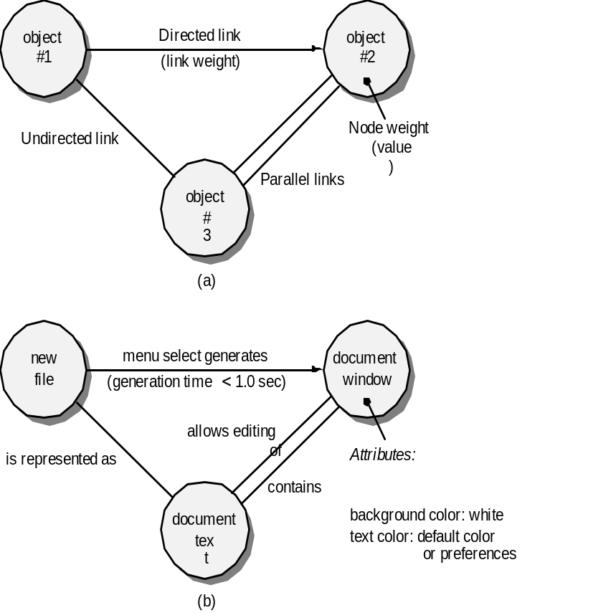
Graph-Based Methods
To understand the objects that are modeled in software and the relationships that connect these objects
In this context, we consider the term “objects” in the broadest possible context. It encompasses data objects, traditional components (modules), and object-oriented elements of computer software.

Slide 35
Black-box Testing
Complements white-box testing by uncovering different classes of errors
Focuses on the functional requirements and the information domain of the software
Used during the later stages of testing after white box testing has been performed
The tester identifies a set of input conditions that will fully exercise all functional requirements for a program
The test cases satisfy the following:
  Reduce, by a count greater than one, the number of additional test cases that must be designed to achieve reasonable testing
  Tell us something about the presence or absence of classes of errors, rather than an error associated only with the specific task at hand

Slide 36
Black-box Testing Categories
Incorrect or missing functions
Interface errors
Errors in data structures or external data base access
Behavior or performance errors
Initialization and termination errors

Slide 37
Questions answered by
Black-box Testing
How is functional validity tested?
How are system behavior and performance tested?
What classes of input will make good test cases?
Is the system particularly sensitive to certain input values?
How are the boundary values of a data class isolated?
What data rates and data volume can the system tolerate?
What effect will specific combinations of data have on system operation?

Slide 38
Equivalence Partitioning
A black-box testing method that divides the input domain of a program into classes of data from which test cases are derived
An ideal test case single-handedly uncovers a complete class of errors, thereby reducing the total number of test cases that must be developed
Test case design is based on an evaluation of equivalence classes for an input condition
An equivalence class represents a set of valid or invalid states for input conditions
From each equivalence class, test cases are selected so that the largest number of attributes of an equivalence class are exercise at once

Slide 39
Equivalence Partitioning
user
queries
output
formats
FK
input
mouse
picks
data
prompts

Slide 40
Guidelines for Defining Equivalence Classes
If an input condition specifies a range, one valid and two invalid equivalence classes are defined
  Input range: 1 – 10 Eq classes: {1..10}, {x < 1}, {x > 10}
If an input condition requires a specific value, one valid and two invalid equivalence classes are defined
  Input value: 250 Eq classes: {250}, {x < 250}, {x > 250}
If an input condition specifies a member of a set, one valid and one invalid equivalence class are defined
  Input set: {-2.5, 7.3, 8.4} Eq classes: {-2.5, 7.3, 8.4}, {any other x}
If an input condition is a Boolean value, one valid and one invalid class are define
  Input: {true condition} Eq classes: {true condition}, {false condition}

Slide 41
Sample Equivalence Classes
Valid data
user supplied commands
responses to system prompts
file names
computational data
physical parameters
bounding values
initiation values
output data formatting
responses to error messages
graphical data (e.g., mouse picks)
Invalid data
data outside bounds of the program
physically impossible data
proper value supplied in wrong place

Slide 42
Boundary Value Analysis
A greater number of errors occur at the boundaries of the input domain rather than in the "center"
Boundary value analysis is a test case design method that complements equivalence partitioning
  It selects test cases at the edges of a class
  It derives test cases from both the input domain and output domain

Slide 43
Boundary Value Analysis
user
queries
output
formats
FK
input
mouse
picks
data
prompts
output
domain
input domain

Slide 44
Guidelines for
Boundary Value Analysis
1. If an input condition specifies a range bounded by values a and b, test cases should be designed with values a and b as well as values just above and just below a and b
2. If an input condition specifies a number of values, test case should be developed that exercise the minimum and maximum numbers. Values just above and just below the minimum and maximum are also tested
Apply guidelines 1 and 2 to output conditions; produce output that reflects the minimum and the maximum values expected; also test the values just below and just above
If internal program data structures have prescribed boundaries (e.g., an array), design a test case to exercise the data structure at its minimum and maximum boundaries

